Slide 1

Automatically Annotate Medical Images for downstream analysis
Capstone Project (Spring 2022)
Li Yuan
Master of Science in Data Science
Data Science Institute, Vanderbilt University
Notes:
Ask questions: grabber

Slide 2
The Goal/Motivation
More and more unlabeled medical images are needed to be annotated for the downstream research analysis. However, manually labeling millions of medical images is impractical. Thus, I want to build an automatic annotator to speed up this process and provide more labeled images for big data analysis.
Notes:
Rather than reading, one sentence to summary

Slide 3
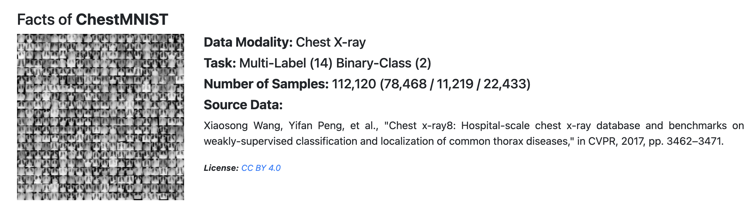
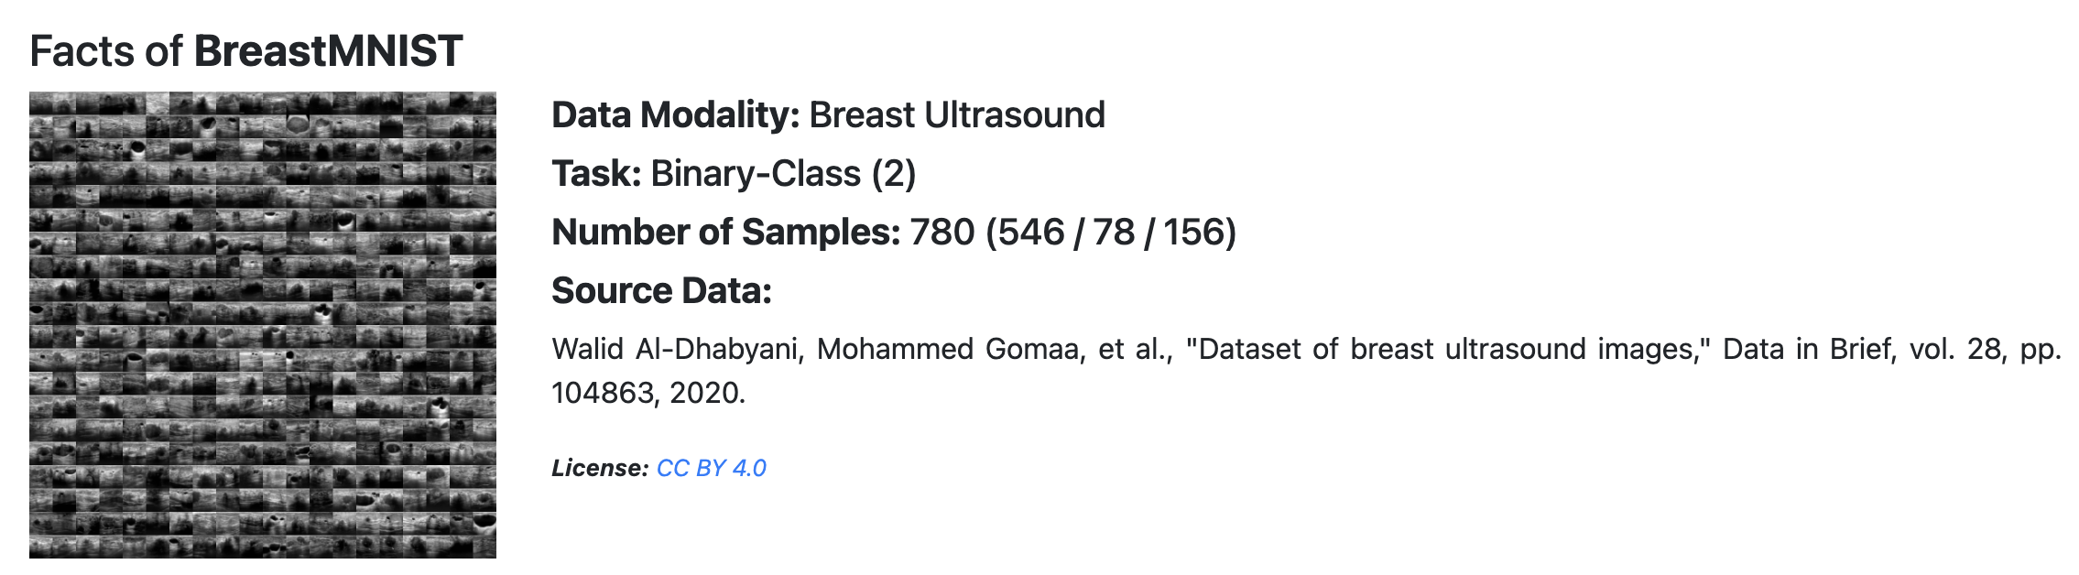
Data Description
MedMNIST v2: A Large-Scale Lightweight Benchmark for 2D and 3D Biomedical Image Classification

Slide 4
Design Modeling
Three Stages:
Directly Apply zero-shot clip model to classify the binary task for recognizing chest or breast images
Train a Convolutional Neural Network to fine tune predictions from the first step
Compare the trained CNN model results with results from CLIP on held-out test set

Slide 5
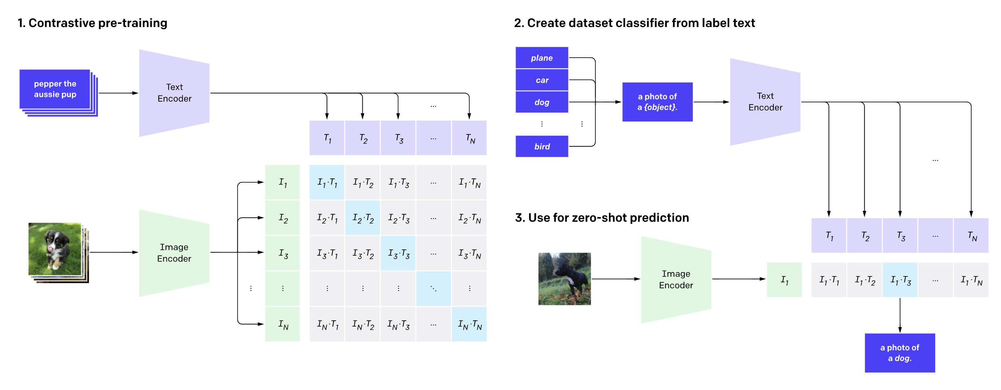
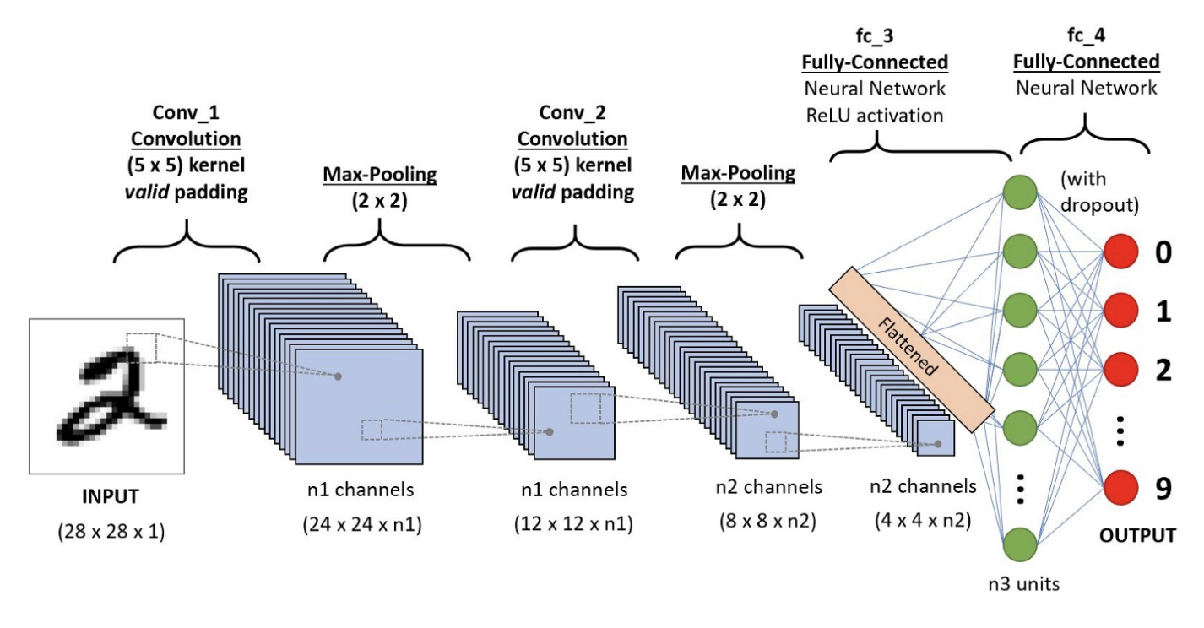
Model Architecture Pipeline
3. Feed training into CLIP
Select half chest images and half breast images
Stratified Split it into training, and test set
5. Apply the trained model on the test to compare with results from CLIP only
4. Feed Training and prediction into CNN

Slide 6
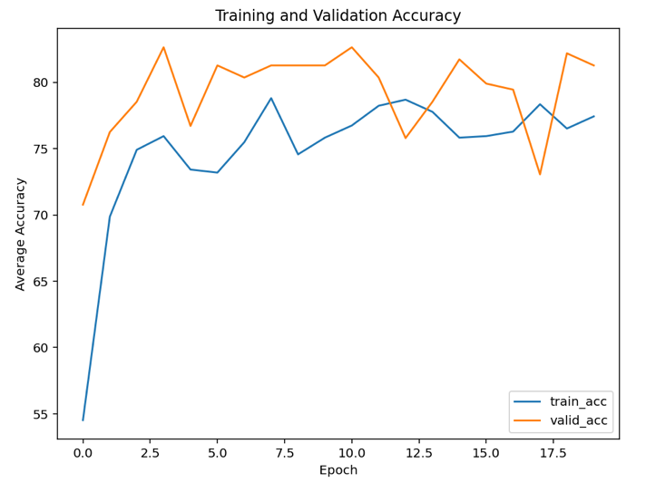
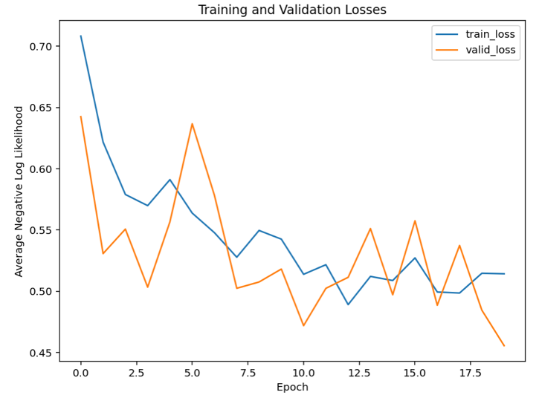
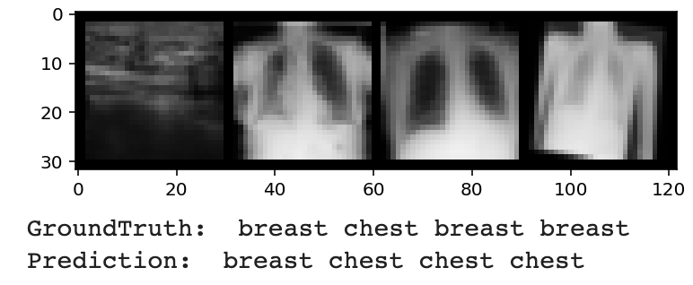
Training and Comparison Results
Obviously, the third and fourth images should be the chest. However, the zero-shot classifies them into the breast. However, the powerful and magic thing is this CNN-trained model can correct the mislabeling in the zero-shot predictions. As we see, the third and the fourth images are classified as chest correctly.
I got 95.72% accuracy on the test set by using trained CNN;
I Got 82.05% accuracy on the test set by using CLIP only

Slide 7
Conclusion
1. After these two stages, the trained CNN model can correct mislabel generated by CLIP because CNN is powerful enough to learn the general pattern from majority correct labels and images. The improvement is huge from 82% to 95%.
2. The Two-Stage model can be used to annotate the chest or breast images for production automatically. Then the labeled medical images can be analyzed in the downstream tasks for more research results and uses.
Thanks, and Q&A
Next Steps
Employ Monai pre-trained medical image models in the current zero-shot CLIP architecture
Once the open AI releases and publish its training codes which are used to train their zero-shot learning models between images and texts, I will plan to use those codes to train on all medical dataset in the MedMNIST benchmark dataset and fine-tune them.
I will plan to test more pairwise datasets, like Blood and Derma, and use different kinds of CNN models

